Slide 2
Generative AI & Azure OpenAI
Hamit Sehjal
Majd Al Mnayer

Slide 3
Topics
What is Generative AI?
What is Prompt Engineering?
What are Tokens?
What is Azure OpenAI?
How to use Azure OpenAI

Slide 4
What is Generative AI?

Slide 5
Introduction to Generative AI
Definition of Generative AI
Comparison with traditional AI
Core functionalities and capabilities
Notes:
Artificial intelligence simulates human intelligence in computers, it is essentially a bunch of algorithms that train on a lot of data. Generative AI is a subset of that, that is trained on creating new content based on the data its trained on.
Generative AI refers to algorithms that can generate new content or data that's never been seen before. Unlike traditional AI, which analyzes and learns from existing data, generative AI can create novel outputs, from text to images and beyond.

Slide 6
Examples of Generative AI
ChatGPT
DALL-E 3
Google Gemini
OpenAI Sora
Midjourney
Notes:
Various examples of generative AI include ChatGPT for text generation, DALL-E 3 for image creation, Google Gemini and OpenAI Sora for advanced AI functionalities, and Midjourney for unique AI-driven journeys.

Slide 7
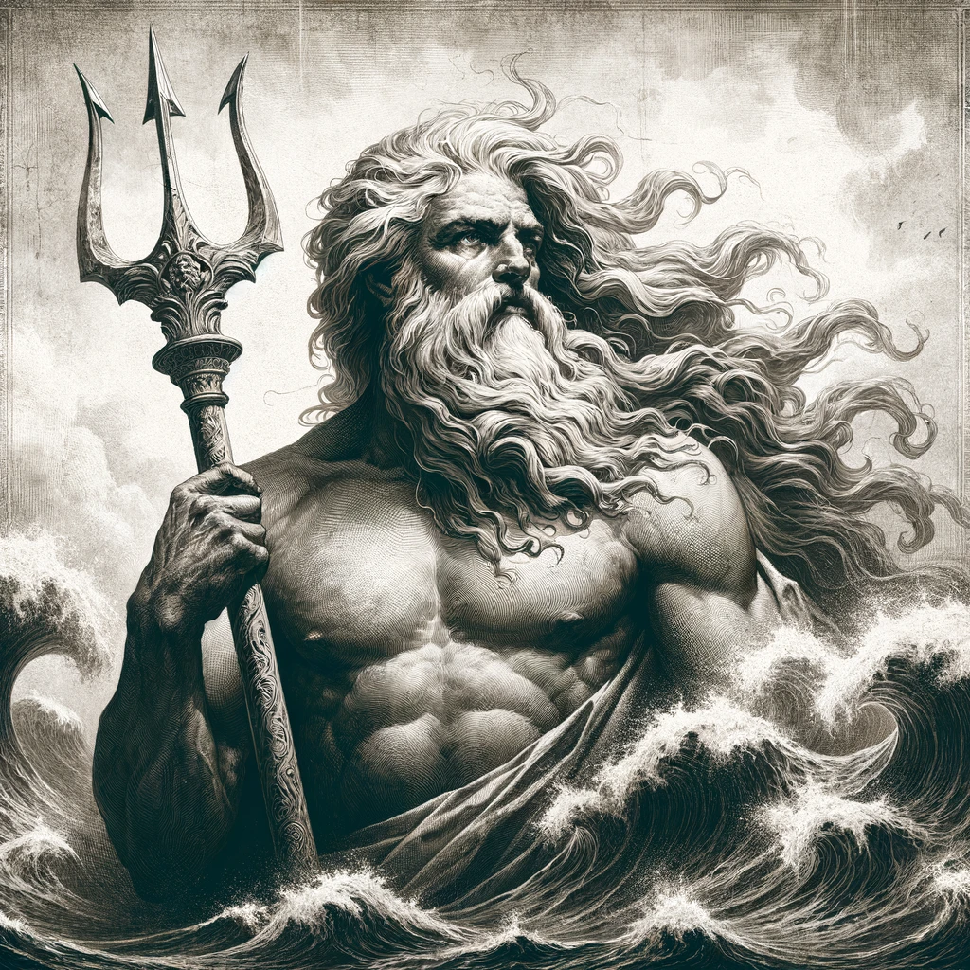
DALL-E 3 - Example
Prompt: Create an image of the Greek god Poseidon, accurately showcasing how he is depicted in the history books.

Slide 8

Sora - Example
Prompt: A stylish woman walks down a Tokyo street filled with warm glowing neon and animated city signage. She wears a black leather jacket, a long red dress, and black boots, and carries a black purse. She wears sunglasses and red lipstick. She walks confidently and casually.

Slide 9

Midjourney - Example
Prompt: A boy with a stick.

Slide 10
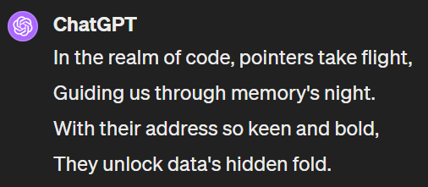
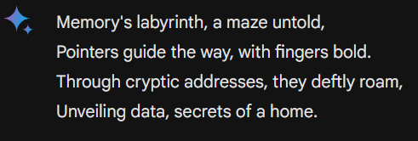
ChatGPT / Gemini - Example
Prompt: Generate a 4-line Poem about pointers.

Slide 11
Applications Across Industries
Healthcare: Drug Discovery, Personalized Medicine
Entertainment: Content Creation
Marketing: Ad Generation, Product Design
Customer Service: Chatbots, Communication Automation
Notes:
Various examples of generative AI include ChatGPT for text generation, DALL-E 3 for image creation, Google Gemini and OpenAI Sora for advanced AI functionalities, and Midjourney for unique AI-driven journeys.

Slide 12
Prompt Engineering? - What is prompt Engineering ? - Why I need to know it ? - Prompt Engineering Techniques ?

Slide 13


What is Prompt Engineering ??
Question
ChatGPT
Answer
LLMs (Large Language Models
prompt
Output
LLMs (Large Language Models
Desirable Output
Optimal Prompt
Best Practices to write an optimal Prompt!!
Notes:
How you use ChatGPT?

Slide 14







Why I need to know Prompt Engineering ??
Generate a Tweet for me
PROMPT
OUTPUT
Billing Process
Amount = prompt(tokens) + output (tokens)
Notes:
Mimic a tweet generator app
Make request to openAI >> cost money
Amount of money you pay for api is propotional to tokens used (input + output)
As a developer, you need to optimize the cost of the app. (Generate revenue or acquire more customers)

Slide 15
Prompt Engineering Techniques
Context-Role-Task
Framework
Few-Shot Learnings
- Be concise
- Use Negative Prompts
- Repeat the Instructions
- Add Length Constraints (Always a Good Idea)
Best Practices
Zero-shot-CoT (Chain of Thought)
One-Short Learnings
Notes:
Imagine telling an AI, 'Close the door.' Without context, the AI might not act as expected. Our skit will show how specifying 'close the door on the right, right now, quietly' guides the AI to perform precisely.

Slide 16
Prompt Example
Bad Prompt: “Give me a suggestion for the main course for today's lunch.“
Good Prompt: “ROLE : You are a nutritionist designing healthy diets for high-performance athletes.
CONTEXT: I do 2 hours of sport a day. I am vegetarian, and I don't like green vegetables. I am conscientious about eating healthily TASK: Based on your expertise defined in your role, give me a suggestion for a main course for today's lunch. With this suggestion, I also want a table with two columns where each row in the table contains an ingredient from the main course. The first column in the table is the name of the ingredient. The second column of the table is the number of grams of that ingredient needed for one person. Do not give the recipe for preparing the main course.”

Slide 17
Prompt-Example: Tweet Generator
return ask_gpt(client,[
{"role":”user","content":“TOPICS: India, Politics, Narendra Modi HASHTAGS: dictatorship, democracy TONE: humorous LENGTH: 240 characters STYLE: informal”"},
{"role":"assistant","content":"Just spotted Narendra Modi sipping tea in a teacup shaped like India!Apparently, it's the latest trend in dictator fashion. Who knew democracy could be so stylish? #TeaTimeWithModi #DemocracyWithStyle #FashionableDictatorship"},
{"role":"user","content":user_prompt}
])
Notes:
One-Shot Learning Examples

Slide 18
What are Tokens?

Slide 19
Understanding Tokens
Definition of tokens in AI
How prompts are broken down into tokens
Each token as a unit of context
Notes:
In AI, tokens are the building blocks of communication. They can be words, punctuation, or any piece of meaningful data. Understanding tokens helps us better design prompts and interpret AI behaviors.

Slide 20
Importance of Tokens
Role in understanding and generating responses
Influence on AI’s performance and accuracy
The official pricing method of AI models
Notes:
Each token provides context that shapes AI's responses. Their significance extends beyond simple words or characters; they encapsulate meaning and intent, directly influencing AI's effectiveness.

Slide 21
Prompt Example
Prompt: Write a funny poem!

Slide 22
Tokens Example
“Write”: A verb that directs an action.
“a”: Helping to specify the task in this context.
“funny”: Adjective, descriptor that helps the AI understand the style.
“poem”: Specifies the type of the content to be generated.
“!”: Provides context regarding tone or urgency of the prompt.
Notes:
Each token provides context that shapes AI's responses. Their significance extends beyond simple words or characters; they encapsulate meaning and intent, directly influencing AI's effectiveness.

Slide 23
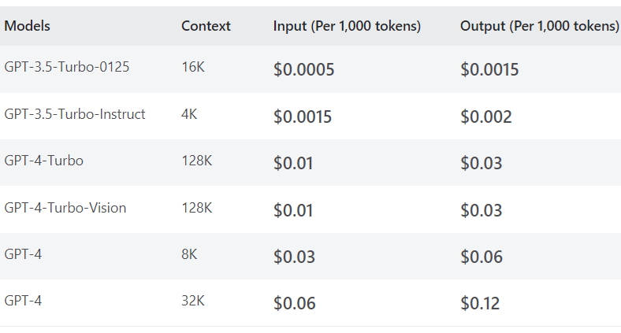
OpenAI - Pricing
Notes:
Each token provides context that shapes AI's responses. Their significance extends beyond simple words or characters; they encapsulate meaning and intent, directly influencing AI's effectiveness.

Slide 24
What is Azure OpenAI?

Slide 25
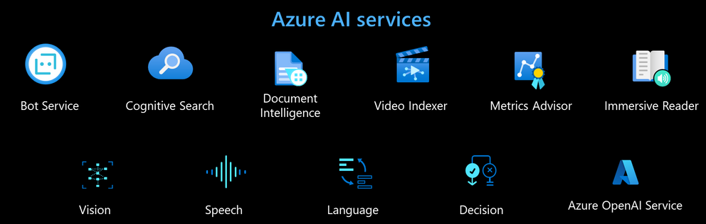
Overview of Azure OpenAI
Notes:
Azure OpenAI Service is a fully managed service that allows developers to easily integrate OpenAI models into their applications. With Azure OpenAI Service, developers can quickly and easily access a wide range of AI models, including natural language processing, computer vision, and more.

Slide 26





Frontend (User Interface)
Internet
Security and Authentication
Backend Server
Database

Slide 27

Customer Success Story - CarMax
Summarize all customer at Scale
Notes:
Azure OpenAI's flexibility allows for the customization of GPT models to suit specific needs, creation of DALL-E 3 models for image generation, and various applications ranging from business solutions to academic research.

Slide 28
How to use Azure OpenAI

Slide 29
Getting Started with Azure OpenAI (JavaScript)
Setting up an Azure account
Accessing OpenAI services
Notes:
To start using Azure OpenAI, you'll need an Azure account. Once set up, you can access a range of OpenAI services, tailor them to your requirements, and integrate AI capabilities into your projects.

Slide 30
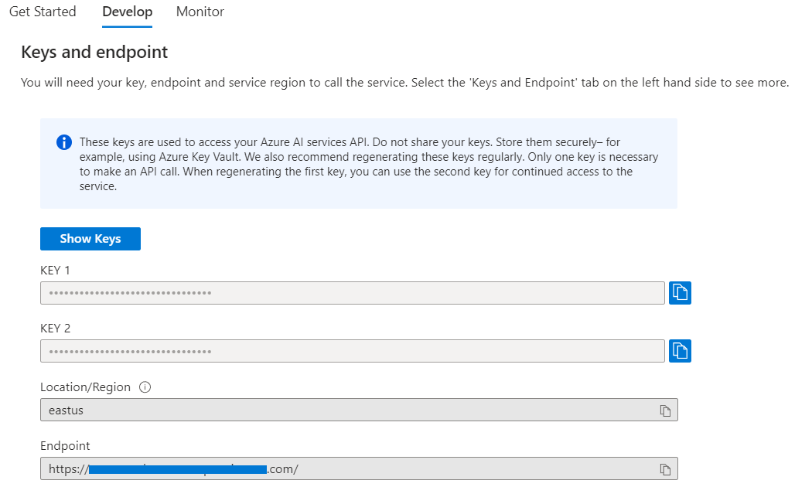
Retrieve All Credentials
Notes:
To start using Azure OpenAI, you'll need an Azure account. Once set up, you can access a range of OpenAI services, tailor them to your requirements, and integrate AI capabilities into your projects.

Slide 31
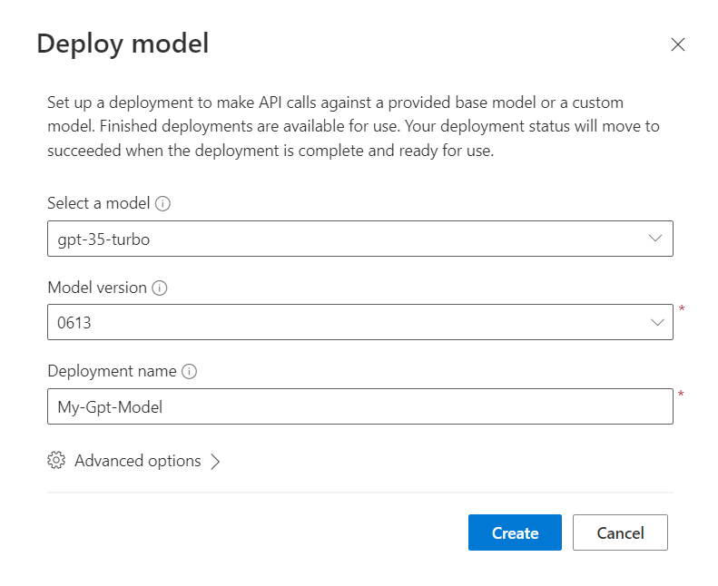
Create Your OpenAI Model
Select a model
Select a model version
Give the model a name
Notes:
To start using Azure OpenAI, you'll need an Azure account. Once set up, you can access a range of OpenAI services, tailor them to your requirements, and integrate AI capabilities into your projects.

Slide 32
Install Dependencies
npm install openai
npm install @azure/openai

Slide 33
Import and Setup
const OpenAI = require("@azure/openai");
const {OpenAIClient, AzureKeyCredential} = OpenAI;
const client = new OpenAIClient(
AZURE_OPENAI_ENDPOINT,
new AzureKeyCredential(AZURE_OPENAI_KEY)
);

Slide 34
Import and Setup
const prompts = [
{
role: "system",
content: system_prompt,
},
{
role: "user",
content: user_prompt,
},
];

Slide 35
Import and Setup
// What you named your model in Azure OpenAI Studio
const deploymentName = OPENAI_DEPLOYMENT_NAME;
// Communicate with the model const result = await client.getChatCompletions(
deploymentName, prompts, {
maxTokens: max_tokens, // 1 - 3500
temperature: temp, // 0.1 - 1
});
return result.choices[0].message.content;

Slide 36
Demo
Majd Al Mnayer

Slide 37
Demo
Hamit Sehjal

Slide 38
Thank You!

